Slide 1
Walmart Sales Prediction
Predicting Weekly Sales Using Regression Analysis
ISYE 6414 Regression Analysis, Fall 2022: Final Project Presentation
Team8: Cheng-Wei Huang, Chin-Heng Lin, Jyh-Heng Yu, Yu-Ching Chen

Slide 2





The Team - Team8
INTRODUCTION
Dr. David Goldsman
Instructor
ISYE 6414
PROBLEM STATEMENT
ANALYSIS
CONCLUSION
Cheng-Wei (Wilson) Huang
Chin-Heng Lin
Jyh-Heng Yu
Yu-Ching Chen

Slide 3

Problem Statement – Walmart Supercenters
INTRODUCTION
Background:
Retail giant: 4755 stores in USA; 5925 stores internationally
Customer source: physical retail location & e-commerce
Sale promotions in national holidays and other regional events
Objective:
Predict future revenue based on historical economic indicators, environmental factors, and sales data
Challenge:
Identify most relevant predictors to weekly sales
Effects between different factors to model
PROBLEM STATEMENT
ANALYSIS
CONCLUSION
Notes:
"Model effects based on regional and seasonal historic data from targeted stores and predict ____"

Slide 4
Data Description
INTRODUCTION
Dataset:
weekly sales for 45 Walmart store within USA from 2010/2/5 to 2012/11/1 _{[1]}
Data count: 6435 observations
Response variable: Weekly_Sales
Factors / Predictors:
Store
Date (Year, Month, Day)
Day of Week
Holiday_Flag
Temperature (°F)
Fuel_Price (dollars/gallon)
CPI (Consumer Price Index)
Unemployment (%)
PROBLEM STATEMENT
ANALYSIS
CONCLUSION
[1] Walmart Dataset, Kaggle Competitions, URL: https://www.kaggle.com/datasets/yasserh/walmart-dataset

Slide 5
Feature Description and Preprocessing
INTRODUCTION
Feature Description:
Split Date into 4 separate columns: Year, Month, Day, Day of Week
Training and Testing Splits with ratio 8:2 (train=5148, test=1287)
Column Name | Description | Variable Type
Store | The store number | Qualitative
Date | The week of sales | Qualitative
Holiday_Flag | Whether the week is a special holiday, 1-holiday week; 0-non holiday week | Qualitative
Temperature | Temperature on the day of sale | Quantitative
Fuel_Price | Cost of the fuel in the region | Quantitative
CPI | Prevailing consumer price index | Quantitative
Unemployment | Prevailing unemployment rate | Quantitative
Weekly_Sales | Weekly sales for the given store | Quantitative
PROBLEM STATEMENT
ANALYSIS
CONCLUSION

Slide 6
Analysis Process
Data Processing
Exploratory Data Analysis
Full/Reduced Multiple Linear Regression
Residual Analysis
Prediction
INTRODUCTION
PROBLEM STATEMENT
ANALYSIS
CONCLUSION

Slide 7
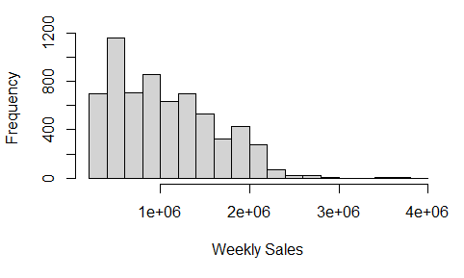
Exploratory Data Analysis
INTRODUCTION
The frequency of response variable Weekly_Sales
Weekly_Sales is around 1 million dollars in most Walmart stores
PROBLEM STATEMENT
ANALYSIS
CONCLUSION

Slide 8
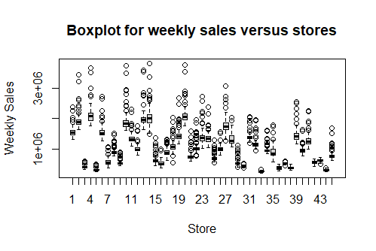
Exploratory Data Analysis
INTRODUCTION
Boxplot for Weekly_Sales versus Store
Store 4, 14, 20 have higher weekly sales while Store 5, 33, 44 have lower weekly sales
PROBLEM STATEMENT
ANALYSIS
CONCLUSION

Slide 9
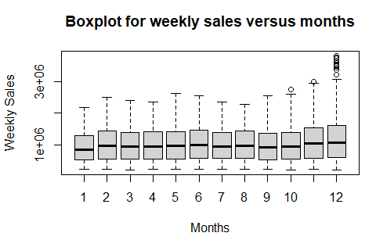
Exploratory Data Analysis
INTRODUCTION
Boxplot for Month versus Store
The average weekly sales in each of the 45 stores are similar
However, there are more data points outside 75th percentile in December
PROBLEM STATEMENT
ANALYSIS
CONCLUSION

Slide 10
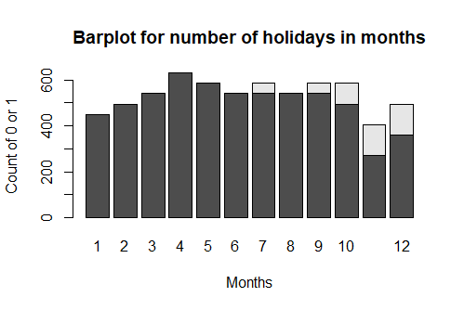
Exploratory Data Analysis
INTRODUCTION
Histogram for Month versus Holiday_Flag
The holiday seasons should be July, September, October, November, and December
PROBLEM STATEMENT
ANALYSIS
CONCLUSION

Slide 11
Regression Analysis – Full model
INTRODUCTION
Model: 98 predictors (complete model)
Insignificant predictor: Store15, Store17, Store22, Store26, Store29, Store35, Store38, Store40, Store42, Year2011, Day10, Day11, Day27, Day30, Weekday1, Weekday4
Adjusted R-square: 94.18%
Improvement process:
Residual analysis
Linearity, independent, normality study
Observe data transformation
Identify outlier (Cook's distance)
Multicollinearity analysis (Variance Inflation Factor (VIF))
PROBLEM STATEMENT
ANALYSIS
CONCLUSION

Slide 12
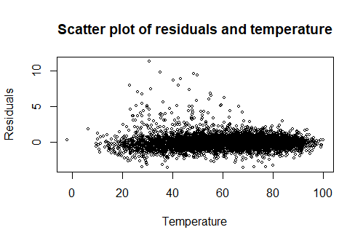
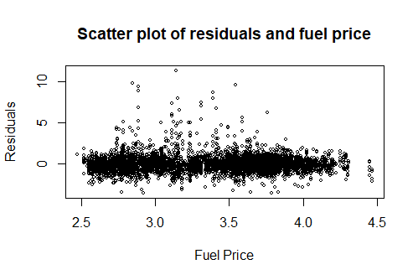
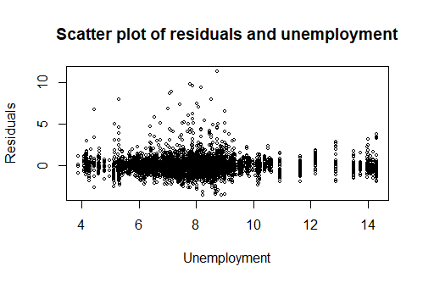
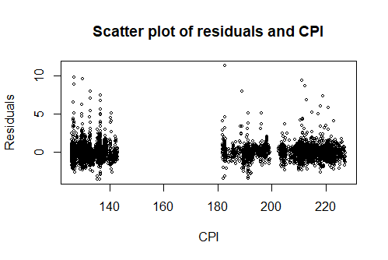
Regression Analysis – Full model
INTRODUCTION
Residual Analysis – Linearity
PROBLEM STATEMENT
ANALYSIS
CONCLUSION

Slide 13
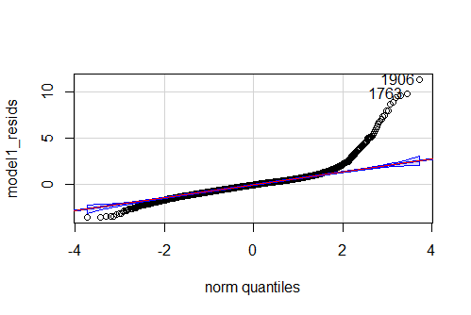
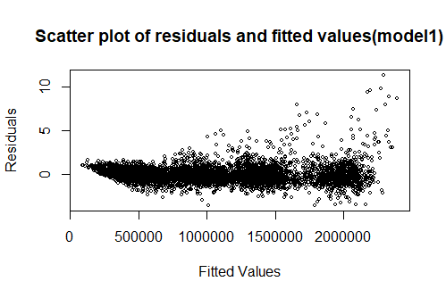
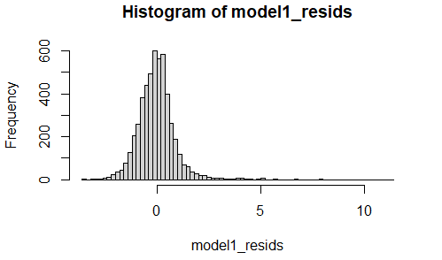
Regression Analysis – Full model
INTRODUCTION
Residual Analysis – Independent & Normality
PROBLEM STATEMENT
ANALYSIS
CONCLUSION

Slide 14
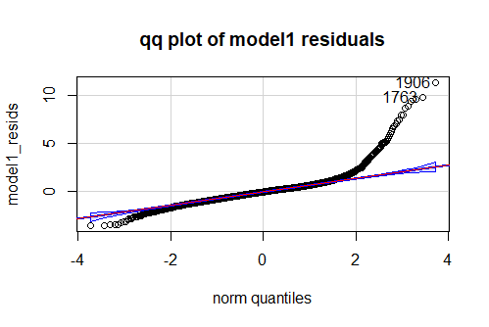
Regression Analysis – Full model
INTRODUCTION
Data transformation – QQ-plot observations
PROBLEM STATEMENT
ANALYSIS
CONCLUSION

Slide 15
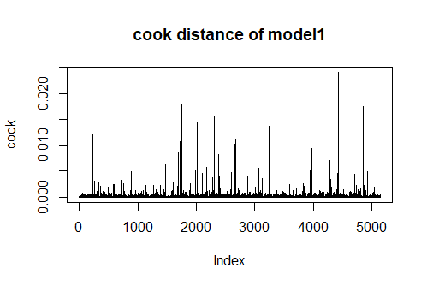
Regression Analysis – Full model
INTRODUCTION
Outlier Selection (Cook's Distance)
Threshold: 4/n = 4/5148 = 0.00078 (n: number of training data)
PROBLEM STATEMENT
ANALYSIS
CONCLUSION

Slide 16
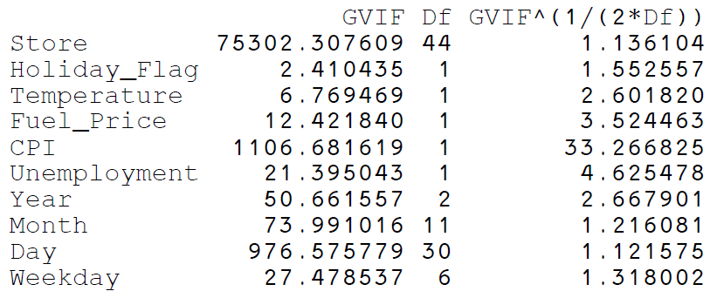
Regression Analysis – Full model
INTRODUCTION
Variance Inflation Factor (VIF)
Consider GVIF^(1/(2*Df)) for variable validation
CPI significantly higher (=33.267)
PROBLEM STATEMENT
ANALYSIS
CONCLUSION

Slide 17
Regression Analysis – Reduced Model
INTRODUCTION
3 improvements we conducted based on the Residuals Analysis
Deleted the outlier with Cook's Distance larger than 0.00077 (4/5148)
Took out the predictor CPI, whose VIF value is large
Fitted the model with Square Root Transformation
PROBLEM STATEMENT
ANALYSIS
CONCLUSION

Slide 18
Model Comparison
 | Model | MSPE | Precision Measure | Adjusted R-squared | R-squared
1 | Full Model | 20,955.845,278 | 0.06593 | 0.9418 | 0.9429
2 | MLR – remove CPI | 21,104,573,984 | 0.0664 | 0.9414 | 0.9425
3 | MLR – remove outlier | 24,732,754,076 | 0.07781 | 0.9751 | 0.9756
4 | MLR – Sqrt transformation | 19,037,280,458 | 0.05989 | 0.9605 | 0.9613
5 | MLR – Sqrt transformation + remove CPI | 19,205,406,402 | 0.06042 | 0.9603 | 0.9611
6 | MLR – Sqrt transformation + remove outlier | 23,502,067,318 | 0.07394 | 0.9784 | 0.9788
7 | MLR – remove outlier + remove CPI | 24,856,912,284 | 0.07820 | 0.9750 | 0.9755
8 | MLR – Sqrt transformation + remove outlier + remove CPI | 23,618.983,170 | 0.07431 | 0.9 | 0.9788
INTRODUCTION
PROBLEM FORMULATION
ANALYSIS
CONCLUSION

Slide 19
Model Comparison
 | Model | Constant Variance | Linearity | Normality
1 | Full Model | X | V | X
2 | MLR – remove CPI | X | V | X
3 | MLR – remove outlier | V | V | X
4 | MLR – Sqrt transformation | X | V | X
5 | MLR – Sqrt transformation + remove CPI | X | V | X
6 | MLR – Sqrt transformation + remove outlier | V | V | X
7 | MLR – remove outlier + remove CPI | V | V | X
8 | MLR – Sqrt transformation + remove outlier + remove CPI | V | V | X
INTRODUCTION
PROBLEM FORMULATION
ANALYSIS
CONCLUSION

Slide 20
Conclusions & Recommendations
INTRODUCTION
Final selected model: Complete multiple linear regression with Square Root Transformation
Foresee seasonal and promotional demand spikes based on regression model
Deep dive the cause of Normality assumption
Include more data with different years
Collect product category data as predictor to better target unfulfilled demand
PROBLEM FORMULATION
ANALYSIS
CONCLUSION

Slide 21
Walmart Sales Prediction
Predicting Weekly Sales Using Regression Analysis
Any Questions?
Thank you!
Team8
Cheng-Wei (Wilson) Huang
Chin-Heng Lin
Jyh-Heng Yu
Yu-Ching Chen

